Slide 1
School Community Council
January 18, 2018

Slide 2
– Welcome – Approval of Minutes 11/16/17

Slide 3
Counselors’ Monthly Update

Slide 4
New DPMS Staff
Carrie Dutson, FACS
Erica Heiner, Theatre

Slide 5
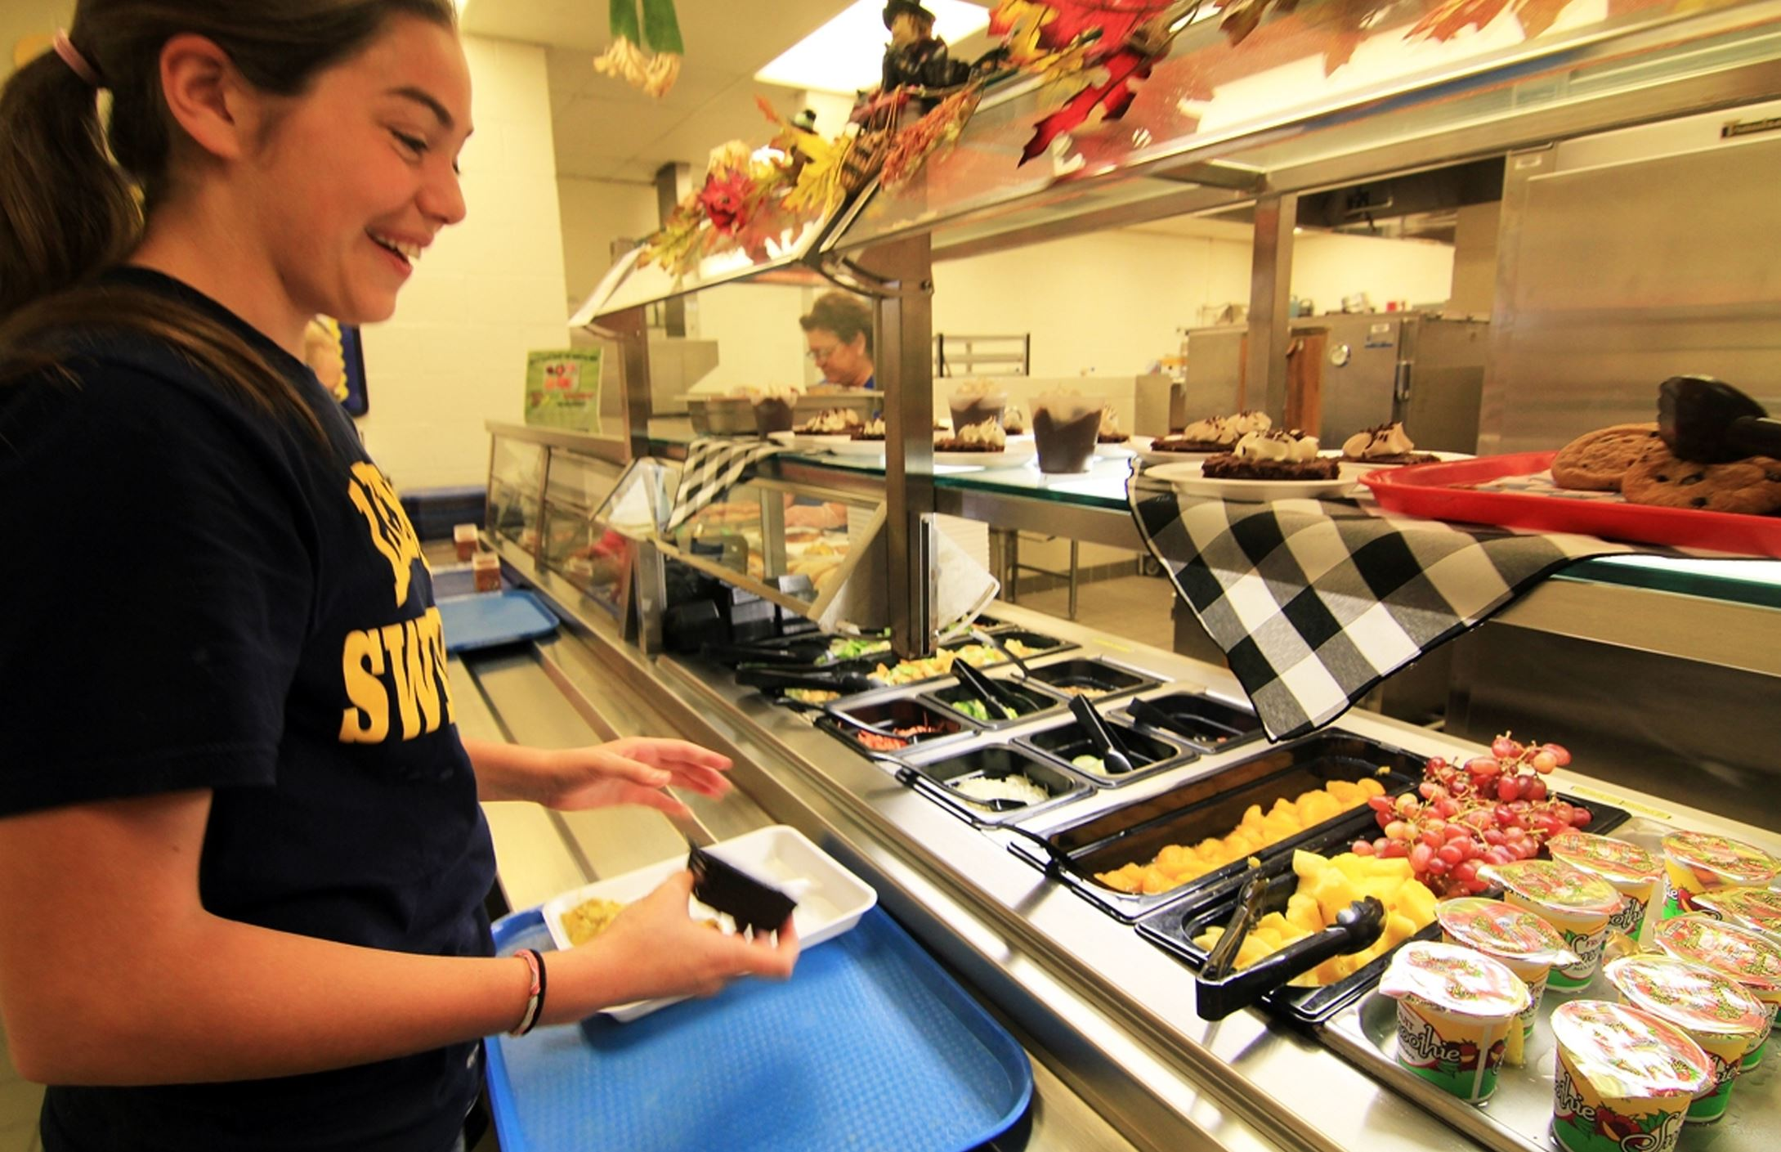
Update on 8th Grade Lunch

Slide 6
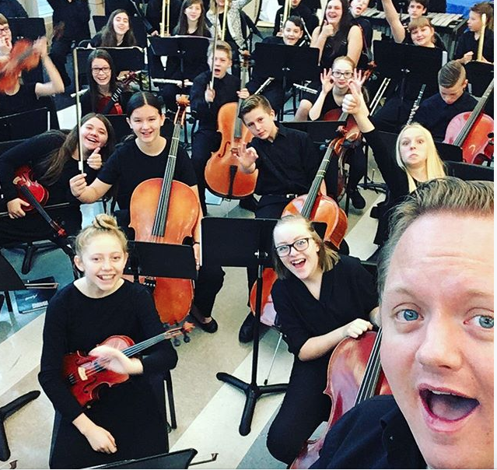
Update Utah State Board of Education’s Revisions to Rule 277-700 (middle school electives)

Slide 7
SCC’s involvement in Teacher of the Year selection

Slide 8
Timeline for School Land Trust & CSIP

Slide 9
Timeline
Feb. 1: Triumvirate – Presentation of DPMS data by district to admin & coaches
Feb. 15: BLT all day meeting with district Instructional Supports Department – CSIP training
Feb. 20: BLT & SCC divided up to look at data and set goals and specify needs for CSIP and Landtrust
7:30 - 11:30 am: BLT CSIP data day - Math & Science am (Media Center - Lunch provided)
10:46 - 2:30 pm: BLT CSIP data day - English & Social Studies pm (Media Center, Lunch provided)
March: Additional date the beginning of March (IF NEEDED)
March 15: SCC meeting to finalize LandTrust
March 30: CSIP & Landtrust due to the district & state

Slide 10
NetSmartz Assembly Feb. 15
Assembly Schedule
6th Grade: 8:22-9:18 a.m.
7th Grade: 9:18-10:15 a.m.
8th Grade: 10:15-11:11 a.m.

Slide 11
Next SCC Meeting
February 15, 2018, 3:00 p.m.
Agenda items due February 7
Agenda posted online February 8

