Slide 1
SCC
10/25/18

Slide 2
Welcome
Heather White
Welcome & Reminder of meeting etiquette

Slide 3
Counselors Monthly Report

Slide 4
Digital Citizenship
Kylie Arbon
http://draperpark.canyonsdistrict.org/scc.html

Slide 5
Schools Living Leader
Meghan Schott
Living Leaders are appointed to promote a healthy school/workplace along with Canyons Living initiatives.
They are responsible for creating wellness activities that all employees can participate in.
  Meghan has created one activity per month that staff can choose to participate in.
Schools are eligible to receive up to $300 in grant money for our program from the district.
  Grant for DPMS: to give away 2 prizes per activity by “drawing names from a hat” of those that participated after each activity in order to promote each event. (Example: A yoga mat and block will be given away after the yoga class.)
  Meghan has submitted the grant but has not heard back yet in regards to its approval.

Slide 6
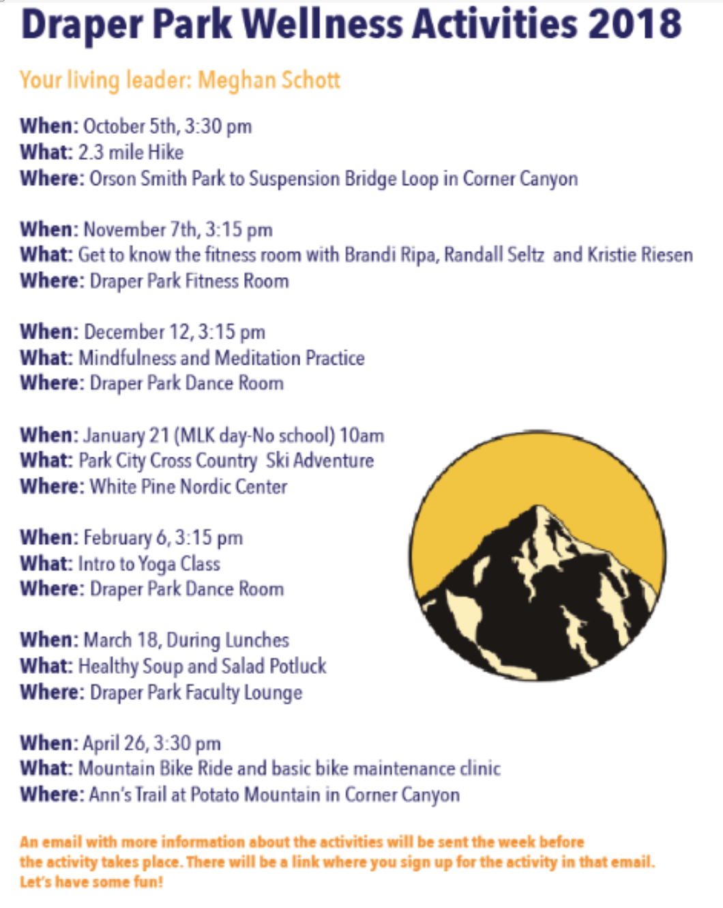

Slide 7
Review & Approve LandTrust
Mary Anderson
MATH
  Goal: Our goal is that by the end of the 2017-2018 year, 68% of students will be proficient on the SAGE assessment. Progress toward this goal will be measured through formative assessments on the Scholastic Math Inventory (SMI) 3 times throughout the year.
  Before and after measurements:
    For sixth grade math lab students, on average had a growth of 129 points on the Scholastic Math Inventory (SMI).
    For seventh grade math lab students, on average had a growth of 238 points on the Scholastic Math Inventory (SMI).
    For eighth grade math lab students, on average had a growth of 123 points on the Scholastic Math Inventory (SMI).
    We had a growth of 5%, going from 61% to 66% of students testing proficient on the Math SAGE.

Slide 8
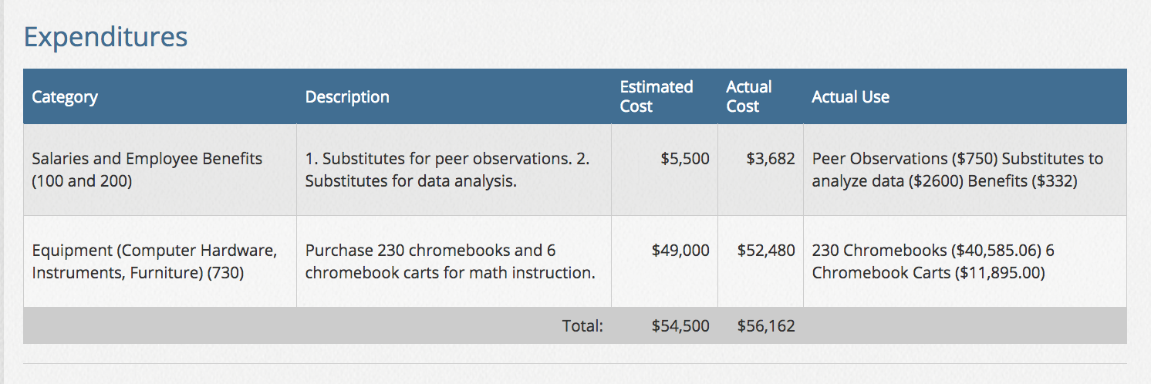
Review & Approve LandTrust
Mary Anderson
Math

Slide 9
Review & Approve LandTrust
Mary Anderson
SCIENCE
  Goal: 77% of our overall student body will achieve proficiency on SAGE in science, while increasing proficiency of Special Education students to 40% in the 2017-18 school year.
  Before and after measurements:
    With the changes to the SAGE science test, data is unavailable at this time.
    Throughout the year, we progress monitored our students by administering unit assessments.
    Overall, science students scored 88% on their end-of-unit science assessments. This exceeded our goal of 80% at mastery.
    School-wide, our resource students scored 62% on their end-of-unit science assessments. This surpassed our goal of having 40% of our special education students reaching mastery on science assessments.
    Additionally, 68% of our special education students in co-taught science class reached mastery on their end-of-unit science assessments.

Slide 10
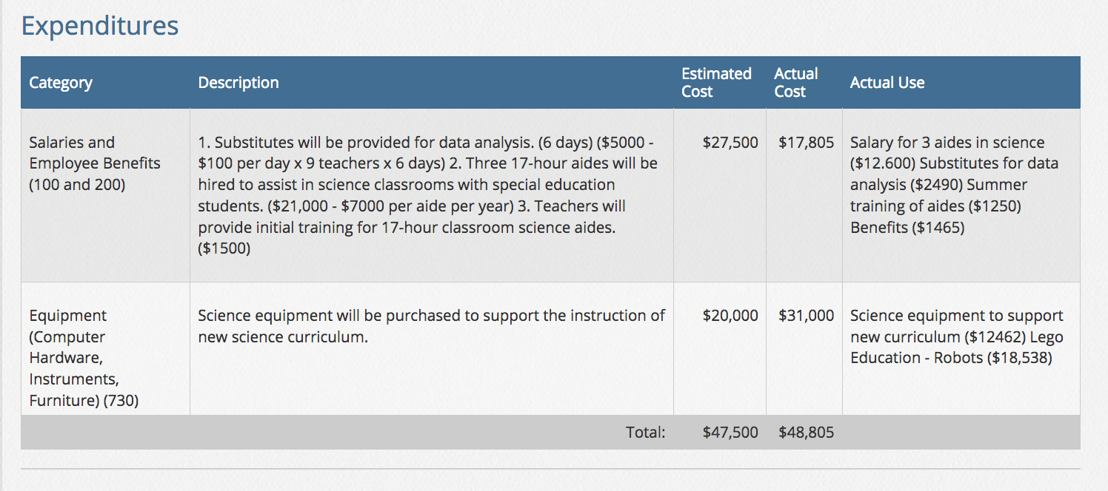
Review & Approve LandTrust
Mary Anderson
Science

Slide 11
Review & Approve LandTrust
Mary Anderson
WRITING
  Goal: at least 68% of our students will be proficient on the Language Arts SAGE in 2017-2018.
  Before and after measurements:
  6th grade improved in thesis, evidence, and elaboration
    By the end of the year, 74% of 6th graders were proficient on thesis, according to the last ELA District Wide Standards Based Assessment (DWSBA).
    For evidence, 2% of 6th graders were proficient at the beginning of the year. At the end of the year, this number had increased to 86%.
    For elaboration, at the beginning of the year, 3% of 6th graders were showing proficiency, which increased to 56% at the end of the year.

Slide 12
Review & Approve LandTrust
Mary Anderson
WRITING
  Goal: at least 68% of our students will be proficient on the Language Arts SAGE in 2017-2018.
  Before and after measurements:
  7th grade improved in thesis, evidence, and elaboration
    By the end of the year, 77% of 7th graders were proficient on thesis
    For evidence, 69% of 7th graders were proficient at the beginning of the year. At the end of the year, this number had increased to 78%.
    For elaboration, at the beginning of the year, 16% of 7th graders were showing proficiency, which increased to 79% at the end of the year.

Slide 13
Review & Approve LandTrust
Mary Anderson
WRITING
  Goal: at least 68% of our students will be proficient on the Language Arts SAGE in 2017-2018.
  Before and after measurements:
  8th grade improved in thesis, evidence, and elaboration
    By the end of the year, 89% of 8th graders were proficient on thesis, according to the last ELA District Wide Standards Based Assessment (DWSBA).
    For evidence, 22% of 8th graders were proficient at the beginning of the year. At the end of the year, this number had increased to 85%.
    For elaboration, at the beginning of the year, 36% of 8th graders were showing proficiency, which increased to 87% at the end of the year.

Slide 14
Review & Approve LandTrust
Mary Anderson
WRITING
  Goal: at least 68% of our students will be proficient on the Language Arts SAGE in 2017-2018.
  Before and after measurements:
  At the end of the year, students took the statewide SAGE ELA test. Overall, each grade-level increased student proficiency from the 2016-2017 assessment when compared to the 2017-2018 exam.
    6th grade increased from 65.1% to 67.4% (+2.3%),
    7th grade increased from 63.8% to 68.2% (+4.4%),
    8th grade increased from 65.7% to 72.6% (+6.9%).

Slide 15
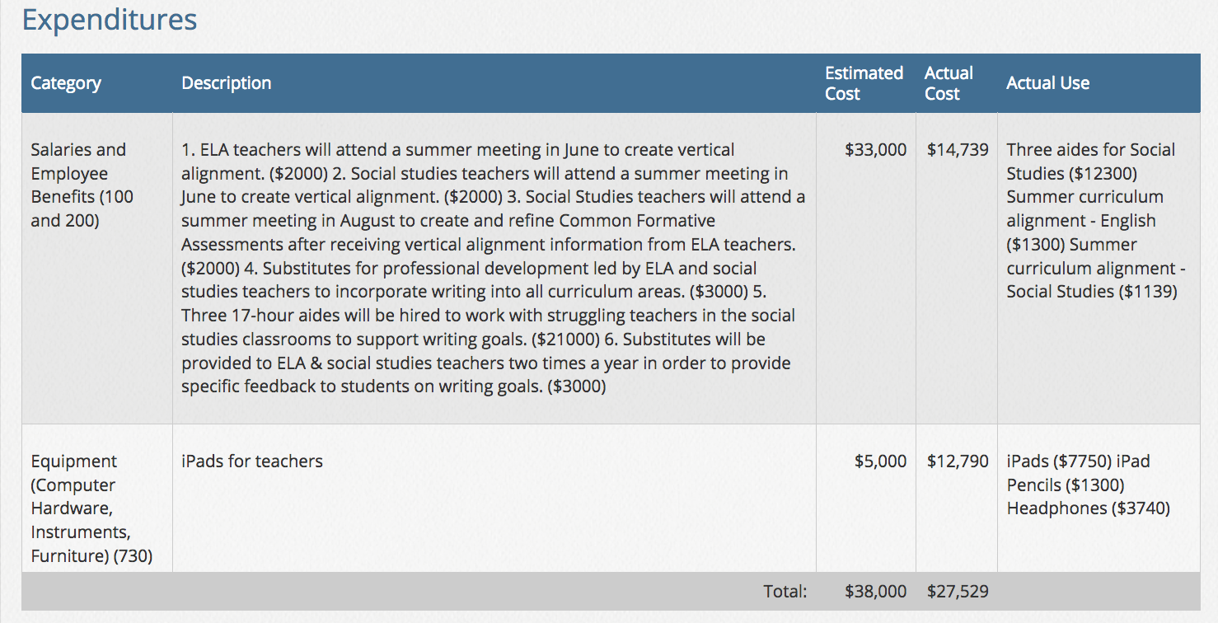
Review & Approve LandTrust
Mary Anderson
Writing

Slide 16
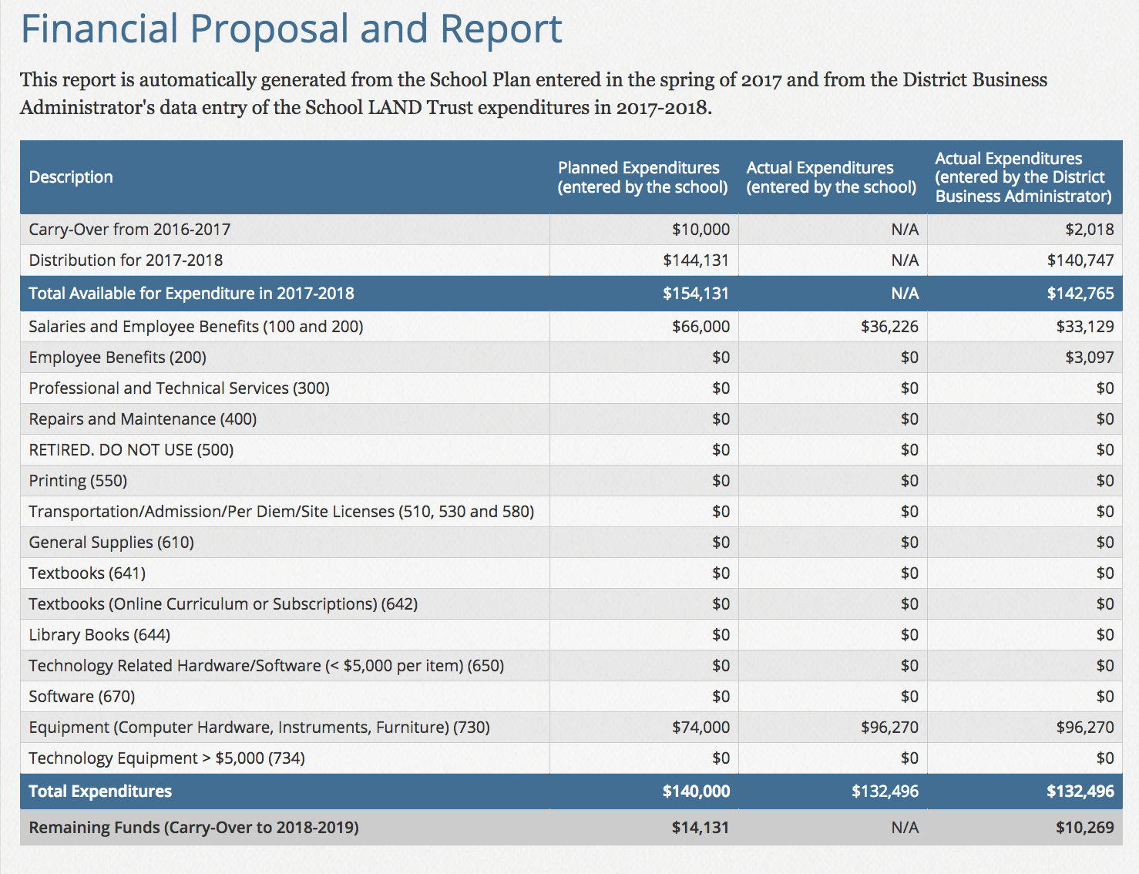
Review & Approve LandTrust
Mary Anderson

Slide 17
Review & Approve LandTrust
Mary Anderson
MOTION to approve the Final Landtrust Report

Slide 18
Safety Drills Timeline @ DPMS
Randall Seltz
August-September: Fire Drill
November: Lockdown and Shelter-in-Place
January: Fire Drill
April: Earthquake
A DPMS Safety Committee comprised of teachers, custodian staff, administrators, and Detective Green meet twice a school year to discuss pertinent safety issues.
As issues come up, our administration uses our school resources (such as Detective Green) to address and resolve individual situations.

Slide 19
Safety - Communication with DPMS Community
Randall Seltz
Randall sends out an email to the community before a drill happens to communicate what will happen and when it will happen.
The emails follow the format the Canyons Communication Department uses to communicate with principals and the whole district
Teachers are reminded what to do for the drill.

Slide 20
Safety - Lockdown and Active Shooter Training
Randall Seltz
All staff were trained at the beginning of the year in the E.S.C.A.P.E. philosophy
DPMS has a whole faculty safety-oriented Remind 101 to communicate during emergency situations
Teachers will be discussing the E.S.C.A.P.E. philosophy with students during the November lockdown drill.
In January 2018, in a coordinated effort with Draper City PD, Draper City Fire and Canyons School District, DPMS held a live active-shooter drill after school on two separate evenings. The training event was designed for both teachers, police, and first responders to practice our protocols.

