Slide 1
STUDENT CENTER
DRAPER PARK MIDDLE SCHOOL
School Community Council Meeting -- November 2019

Slide 2
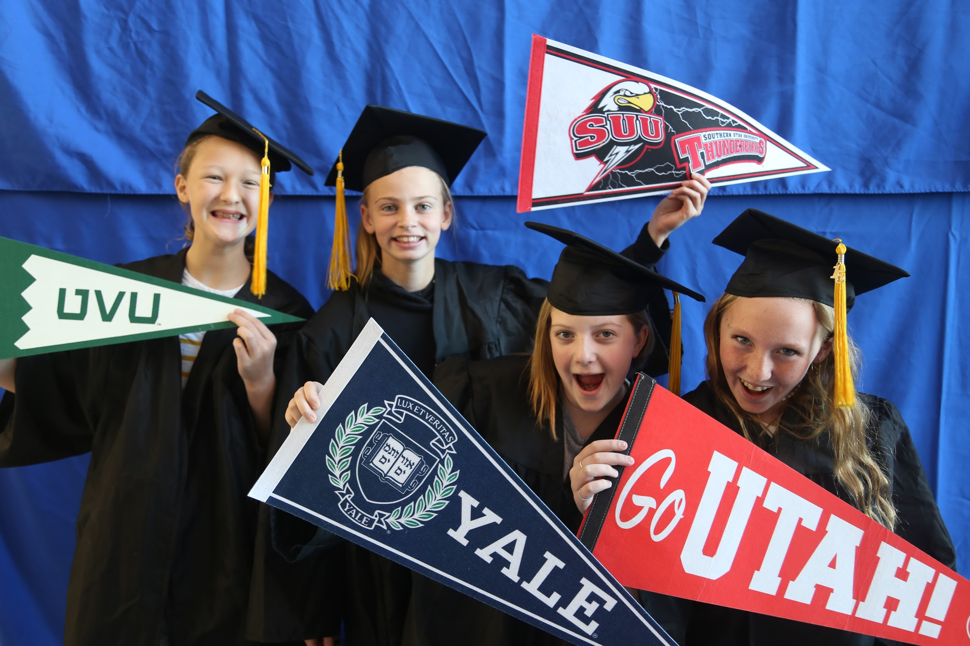
Recap Time
Collaborative Classroom Instruction Activities
8th grade Four Year Plan and Beyond
8th grade Stress Management/Outsiders
7th grade College & Career Readiness Meetings
6th Grade Organization/Study Skills
6th Grade Teamwork
Utah College Application Week (October 14-18)
Cap & Gown Pictures
Grab your College Dreams
Spot the Mascot
Orange out National Unity Day
Collaboration with Salt Lake County
Lunch time activities: Kindness, Pass it On!
Tracker Program
20 Students on Program
Club Thursday
Gratitude Journals
Games (Card, Bunco, sports, etc)
FACS: cooking (ice cream, crepes, muddy buddies) and sewing
Dia De Los Muertos(Face painting, street tacos, mini pinatas)
Hale Center Theatre

Slide 3
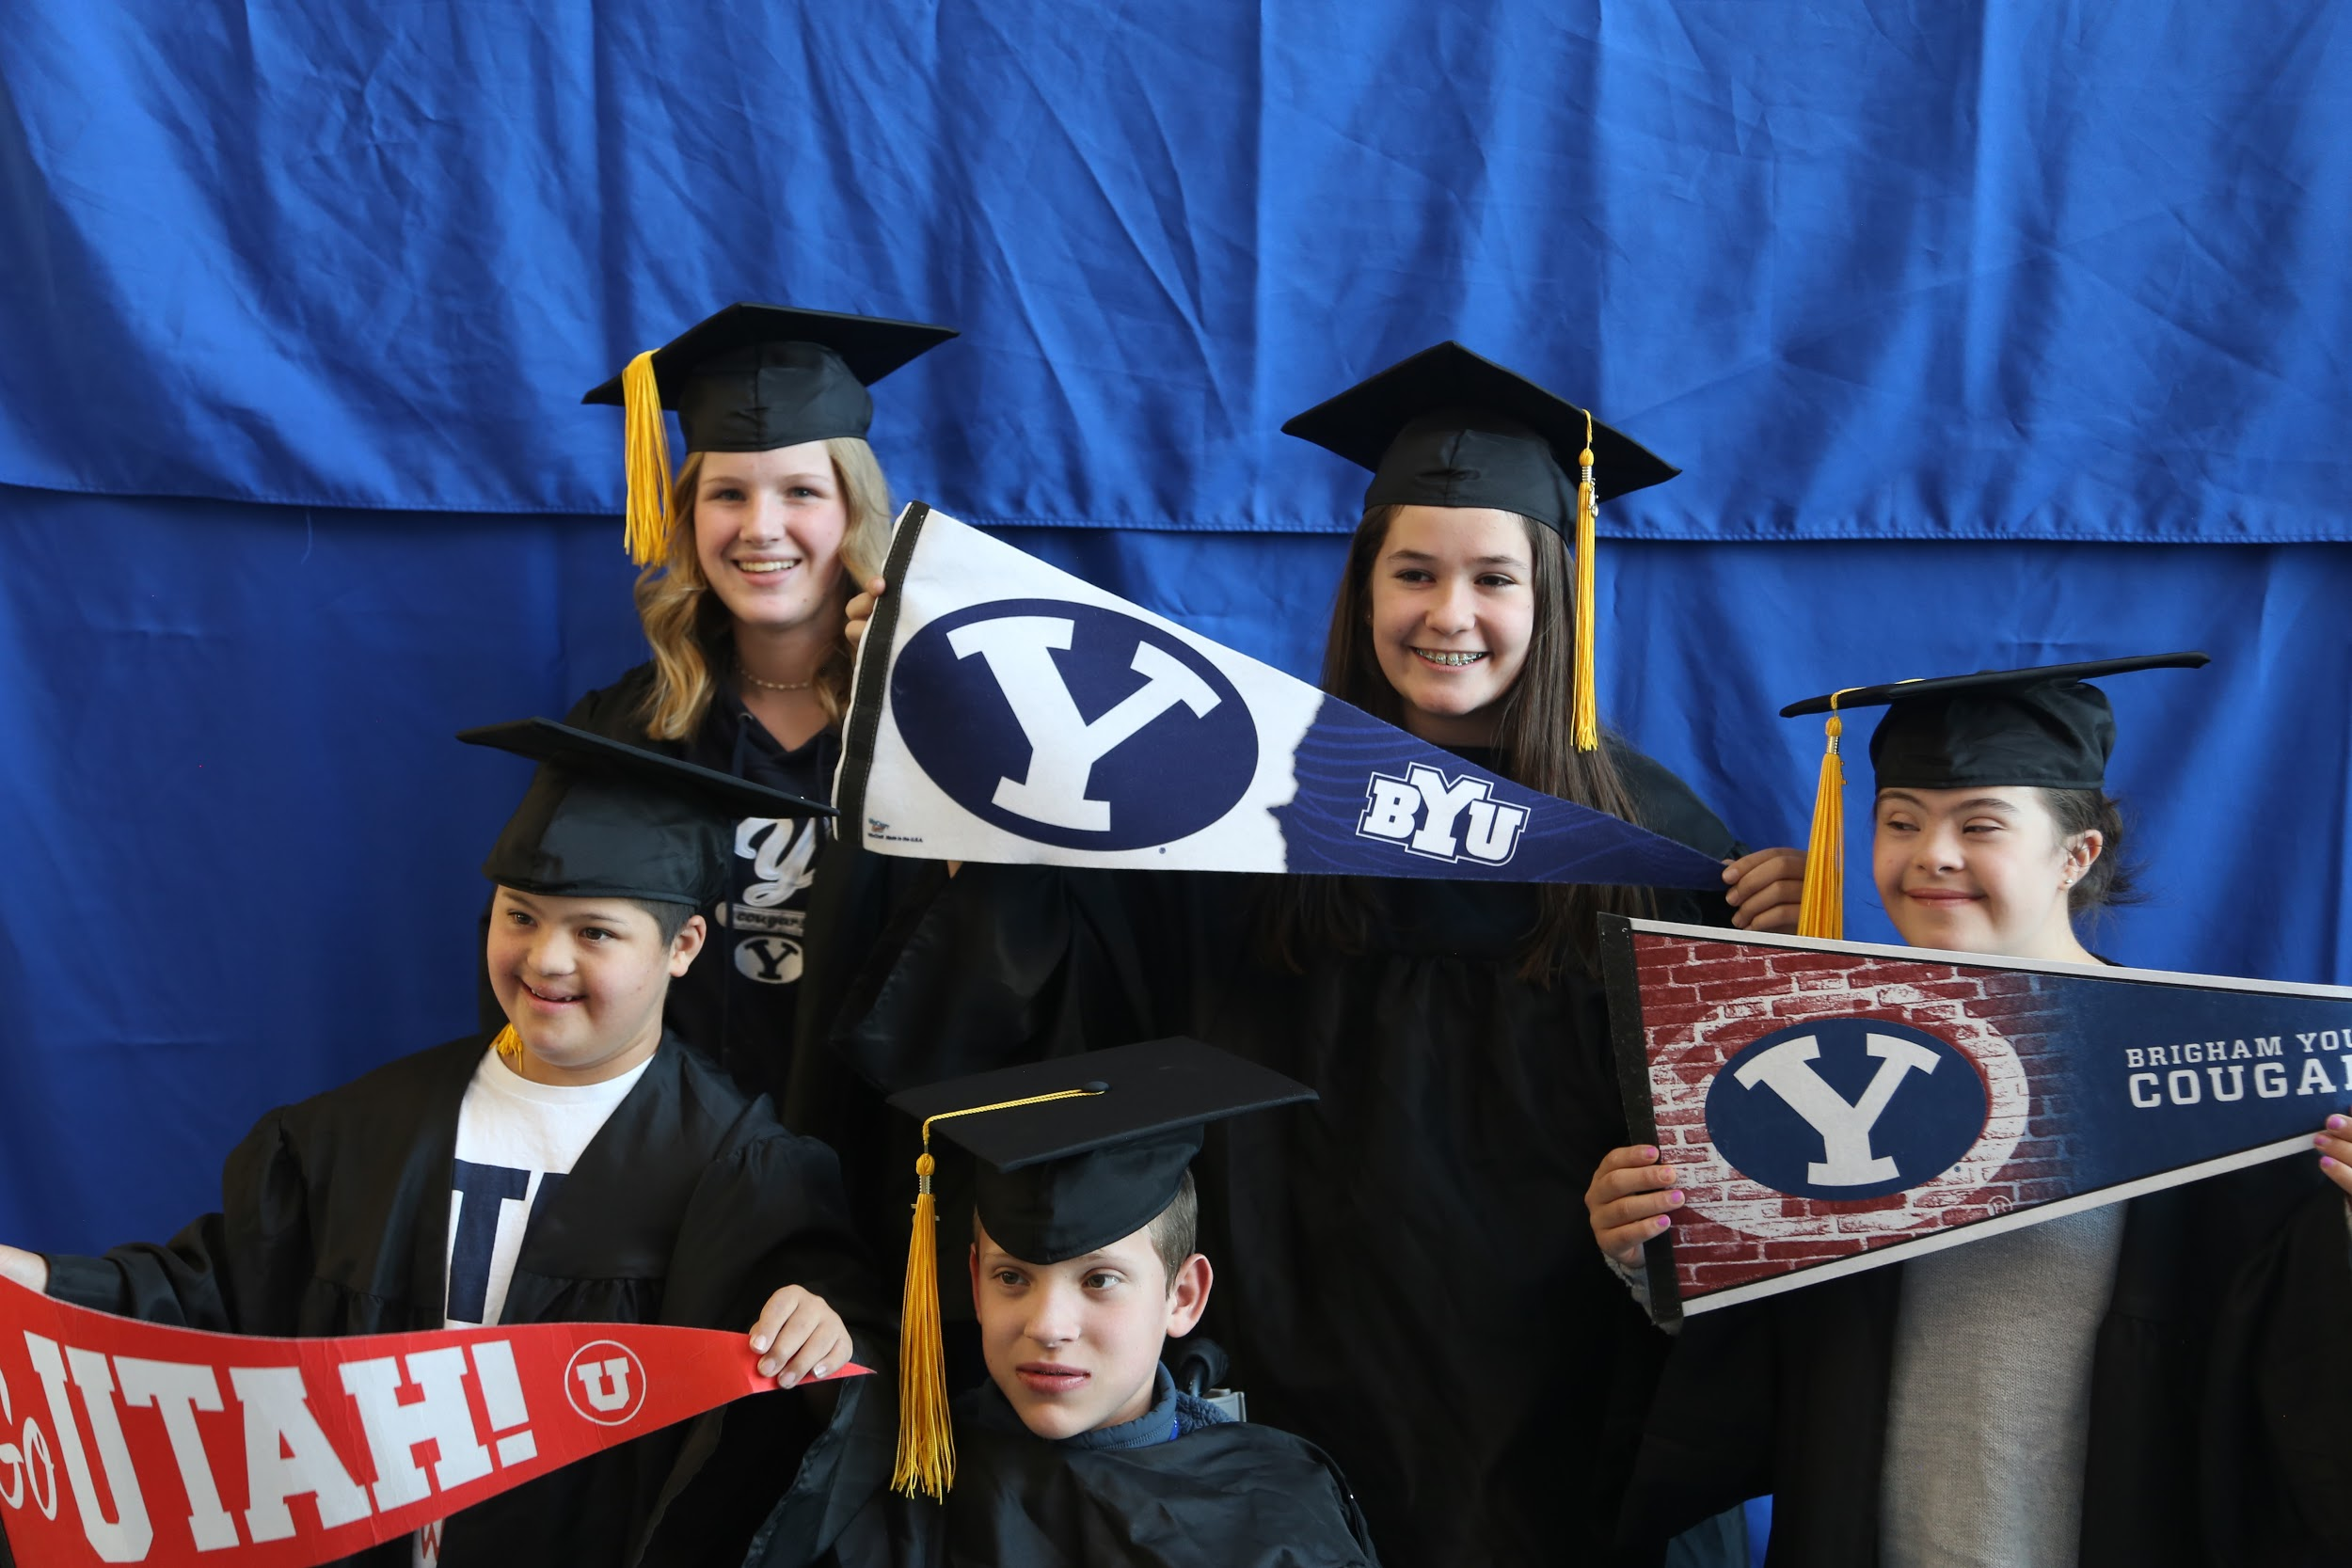
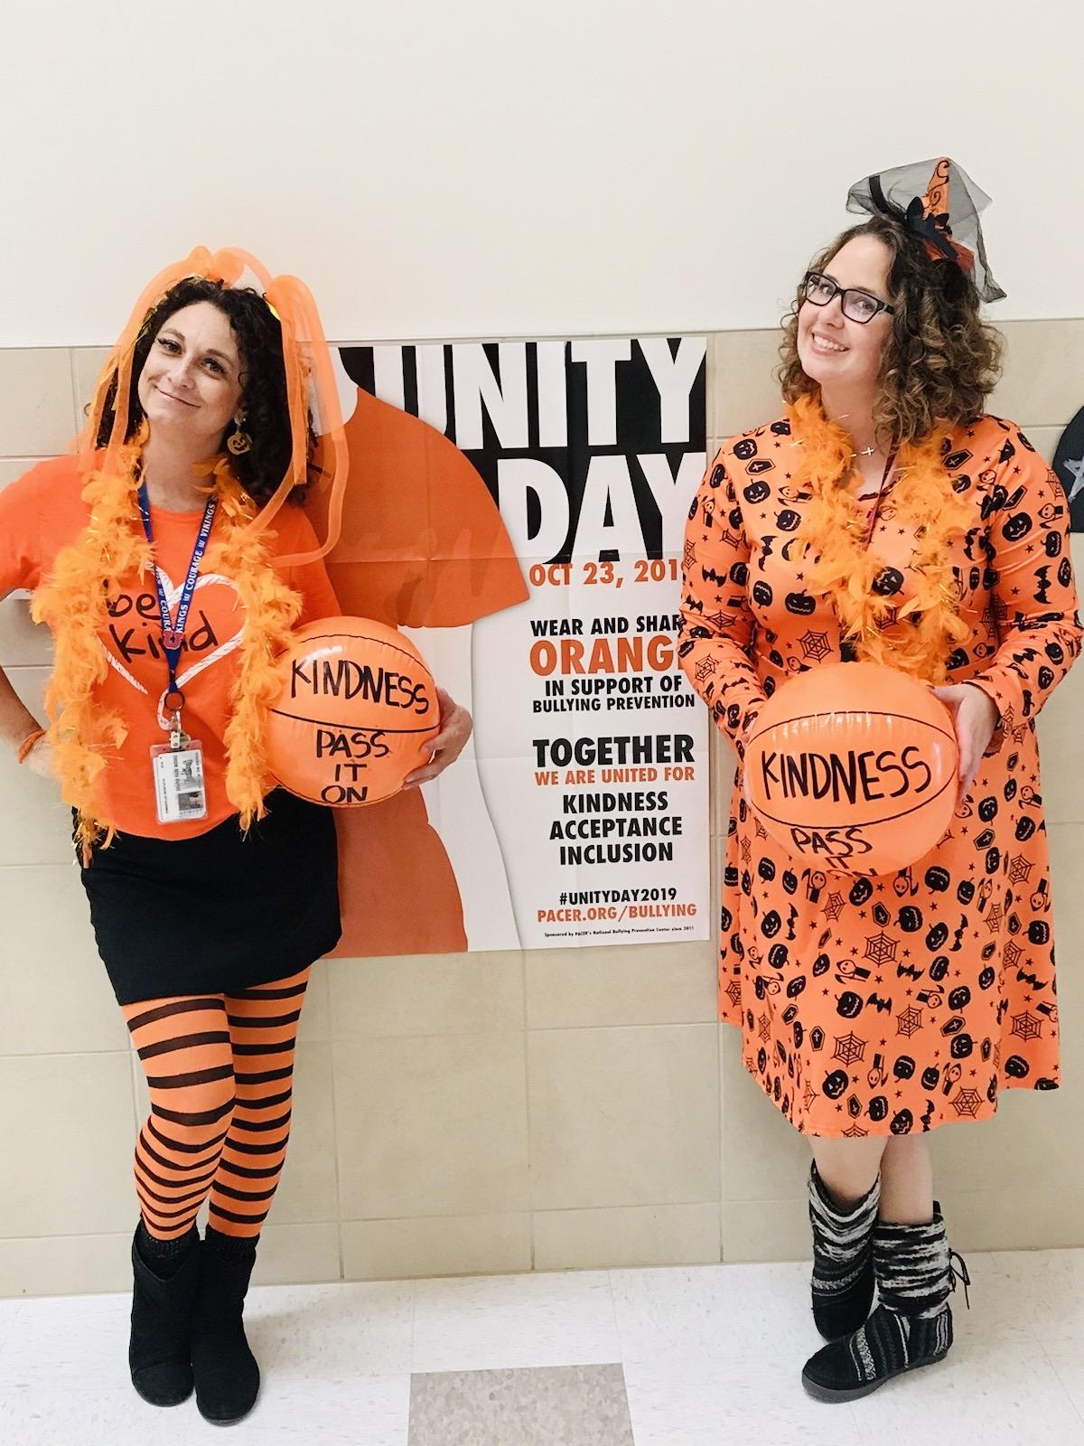
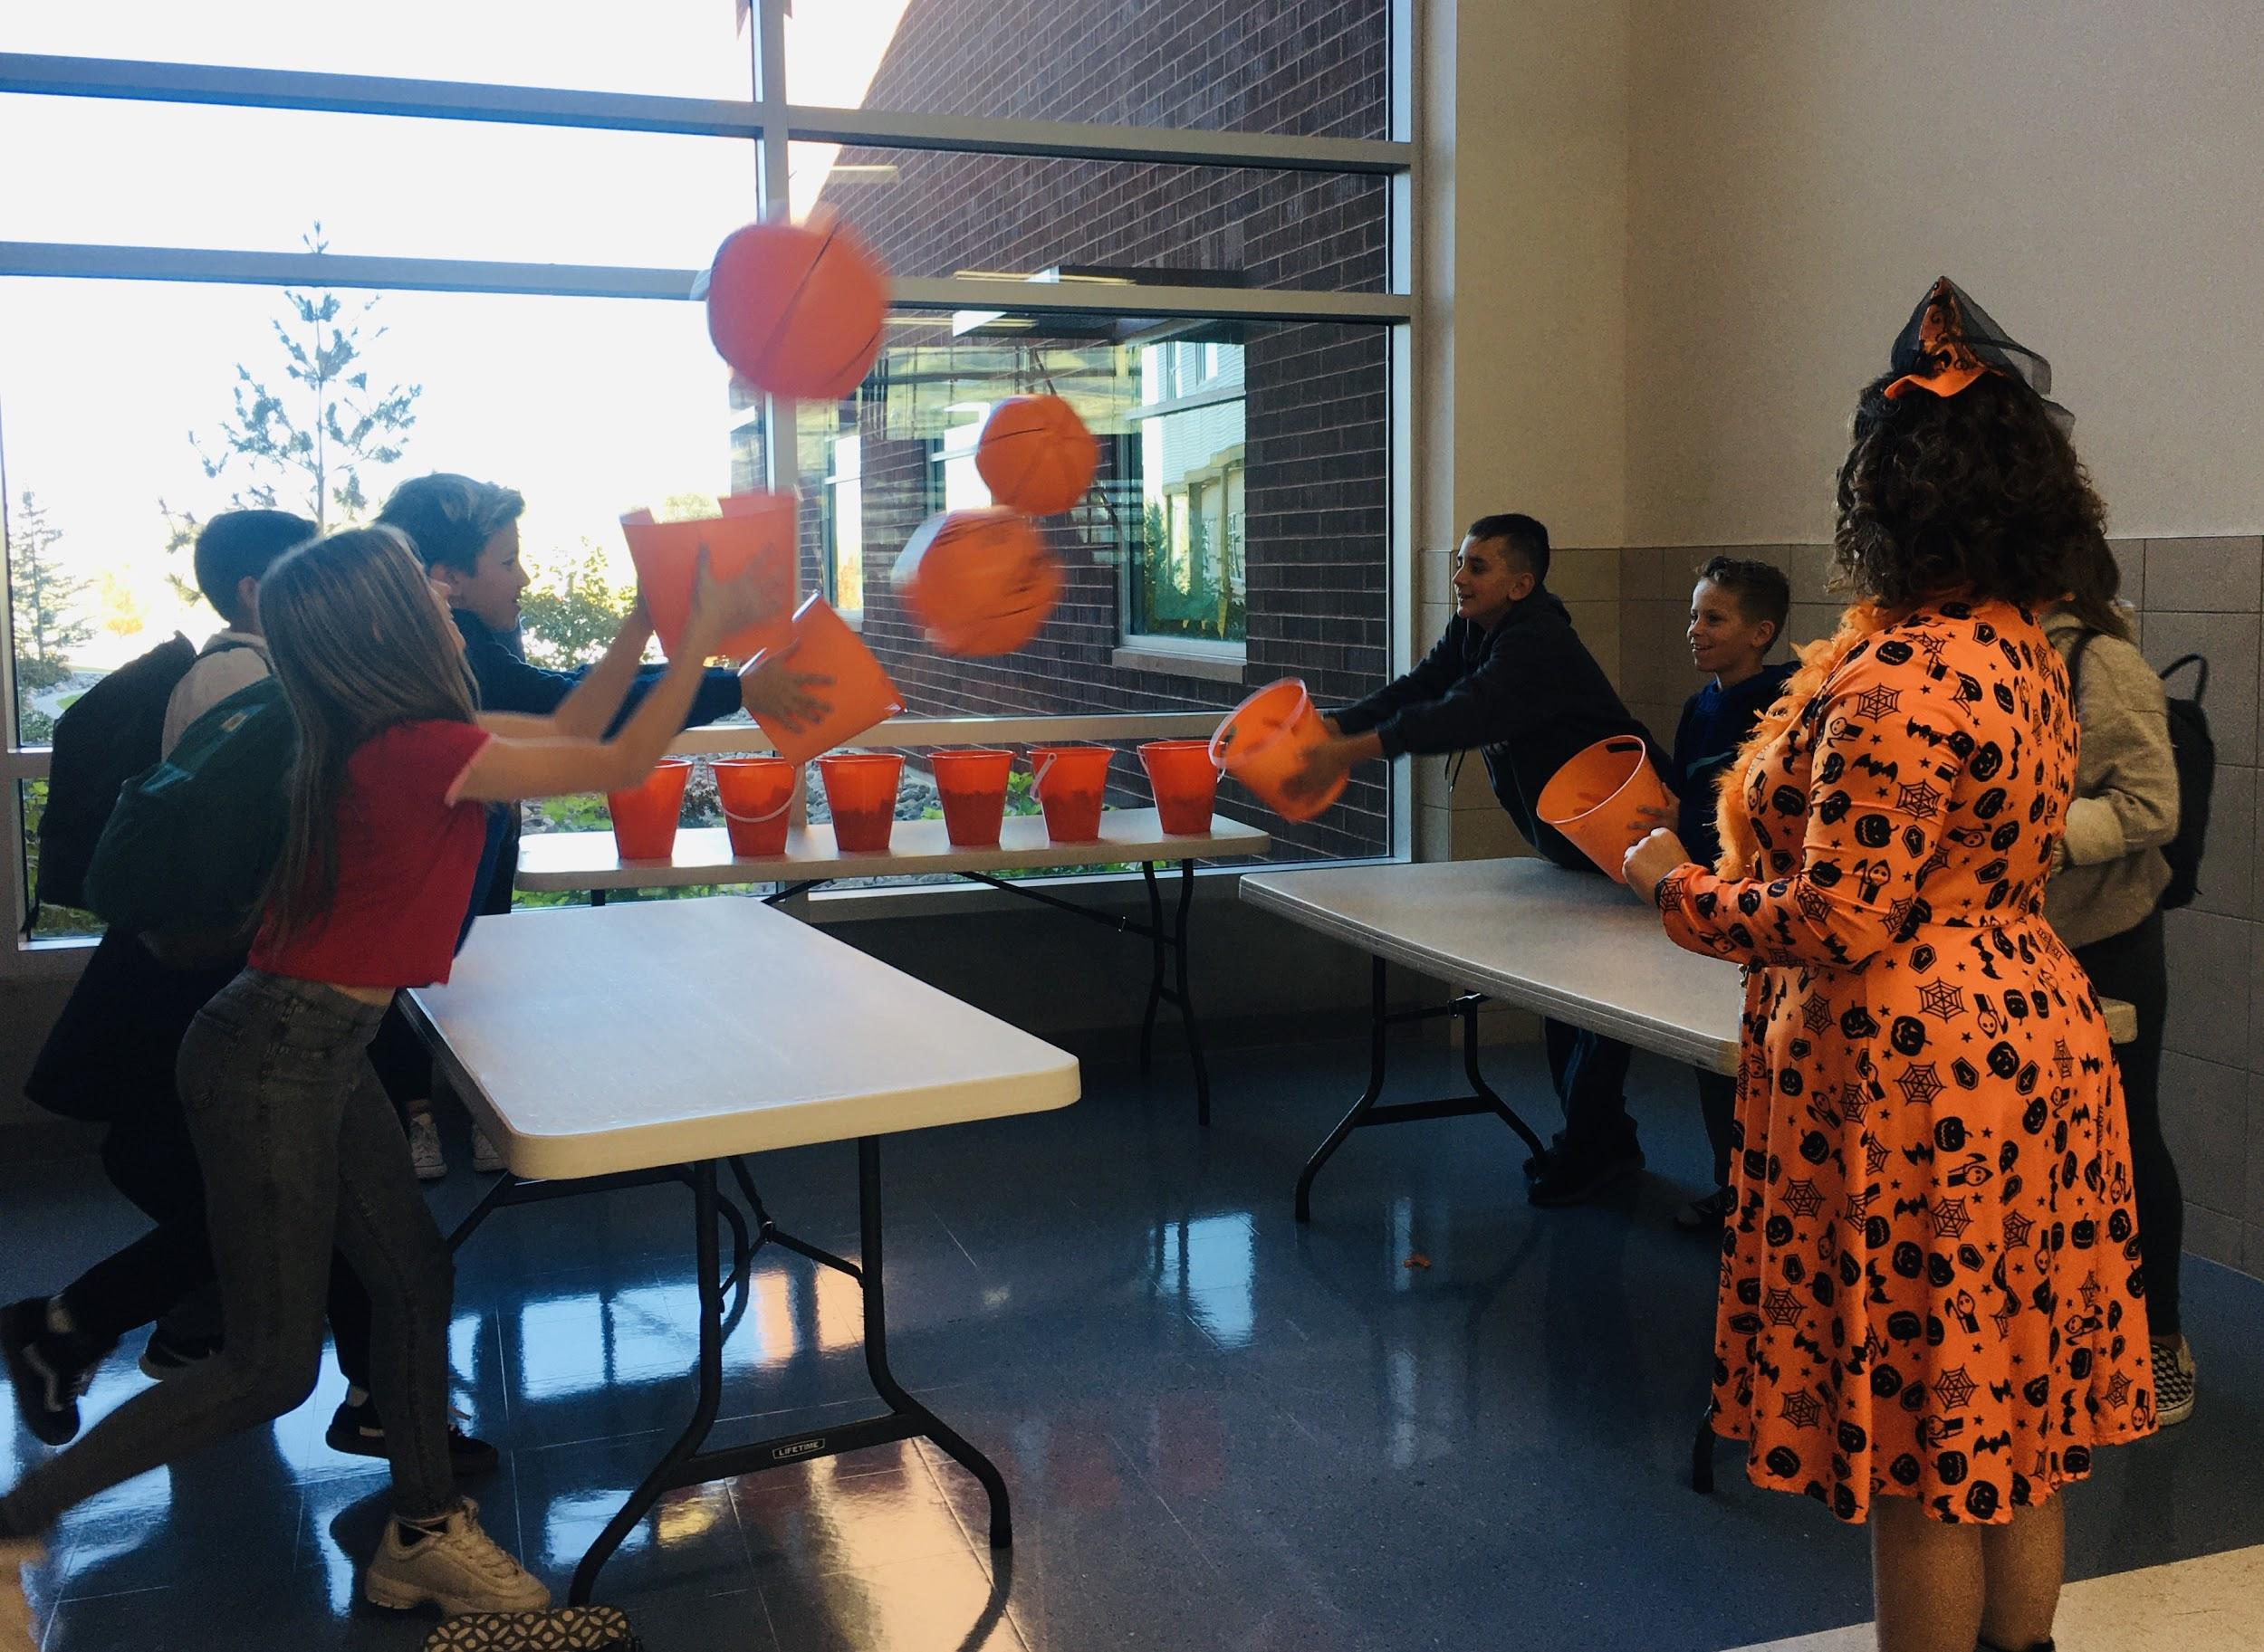

Slide 4
Plan for College & Career Readiness
“All Students should have education and career goals that prepare them to experience fulfilling lives, actively participate in their communities, and succeed in a competitive economy.”
(Utah State Board of Education and the Utah System of Higher Education)
At DPMS our collaborative classroom instruction lessons help students become College & Career Ready. The College & Career meetings that we have with students help review the following principles:
Build a strong academic foundation
Strengthen transferable skills
Explore college campuses and learn about the different ways to pay for education
Pay attention to details
Evaluate progress
Utah State Board of Education and the Utah System of Higher Education College & Career Readiness Recommendations

Slide 5
WHAT WE DO: PLAN FOR COLLEGE & CAREER READINESS
7th Grade (580 Students):
All Students:
September
Individual Meeting with Students during Utah Studies Classes
Surveyed & Discussed
Dream careers, School progress, study skills
Set Goals
Assessed Career Interested for Career Exploration Speakers
Started with Ivy League Schools presentation (August 30)

Slide 6
WHAT WE DO: PLAN FOR COLLEGE & CAREER READINESS
8th Grade (518 Students current 11/2019):
All Students:
September -- December
Individual Meeting with Students and Parents
Discuss Current 8th grade progress, strengths & challenges
Explained High School Requirements
Review 7th Grade YOU Going Forward Booklet
Set Goals for High School & Beyond
Discussed Career Interest
Data
Appointments: 253 with Completed parents
223 more scheduled with parents
476 total scheduled & completed— 92% parent involvement scheduled and/or completed
To Do: 41 students not scheduled
Emails, Skylerts, Multiple personal phone calls

Slide 7
Upcoming Events
Club Thursday
11/14: Sewing project, card games, Chinese art project, service club
11/21: Thanksgiving rolls, Festival of Trees craft/service project, Math & Music google lab
12/5: Christmas craft, bath bombs, pasta making
12/12: Chocolate popcorn, 3-D Christmas tree paper craft
12/19: Christmas cookies, origami & caroling
Schedule Changes
Semester 2 change requests will be limited (Semester begins January 21st)
January 7th & 8th request window will be open
Before the school year began:
107 6th grade requests
165 7th grade requests
244 8th grade requests
516 total schedule change requests
Student schedules:
9% overall conflict rate (1620ish students originally scheduled)
roughly 146 students did not receive all of their top 4 elective choices
between 25-30% of students are requesting to change their original requests

